Slide 1
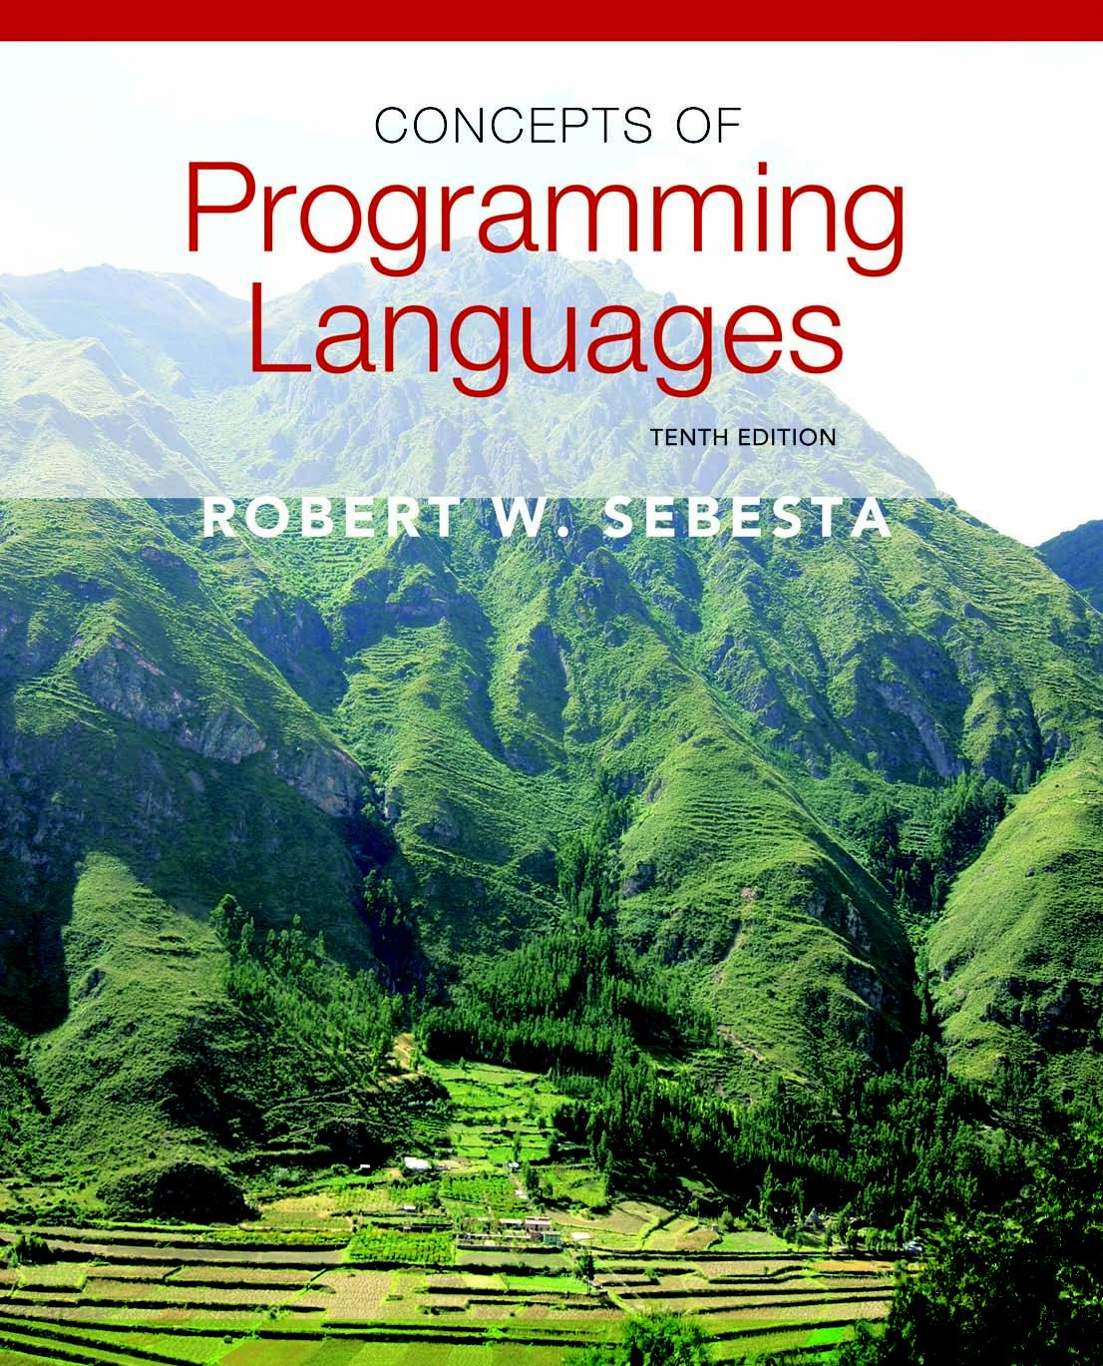
Chapter 1
Preliminaries

Slide 2
Summary
What are we going to talk about today?
Programming domains
Language design
Language Implementation
Environments

Slide 3
Programming Domains
Any domains?
Scientific applications
Large numbers of floating point computations; use of arrays
Fortran
Business applications
Produce reports, use decimal numbers and characters
COBOL (Common Business Oriented Language)
Artificial intelligence
Symbols rather than numbers manipulated; use of linked lists
LISP
Systems programming
Need efficiency
C
Web Software
Eclectic collection of languages: markup (e.g., HTML), scripting (e.g., PHP)

Slide 4
Language Evaluation Criteria
How can you evaluate a programming language?
Readability: the ease with which programs can be read and understood
Writability: the ease with which a language can be used to create programs
Reliability: conformance to specifications (i.e., performs to its specifications)
Cost: the ultimate total cost

Slide 5
Evaluation Criteria: Readability
What affects readability?
Overall simplicity
A manageable set of features and constructs
Minimal feature multiplicity
Minimal operator overloading
Orthogonality
A relatively small set of primitive constructs can be combined in a relatively small number of ways
Every possible combination is legal
Data types
Adequate predefined data types
Syntax considerations
Identifier forms: flexible composition
Special words and methods of forming compound statements
Form and meaning: self-descriptive constructs, meaningful keywords

Slide 6
Evaluation Criteria: Writability
What makes it easier to write a PL?
Simplicity and orthogonality
Few constructs, a small number of primitives, a small set of rules for combining them
Support for abstraction
The ability to define and use complex structures or operations in ways that allow details to be ignored
Expressivity
A set of relatively convenient ways of specifying operations
Strength and number of operators and predefined functions
Count++
Subprogram, functions
+ operator

Slide 7
Evaluation Criteria: Reliability
Type checking
Testing for type errors
Exception handling
Intercept run-time errors and take corrective measures
Aliasing
Presence of two or more distinct referencing methods for the same memory location
Readability and writability
A language that does not support “natural” ways of expressing an algorithm will require the use of “unnatural” approaches, and hence reduced reliability

Slide 8
Evaluation Criteria: Cost
Training programmers to use the language
Writing programs (closeness to particular applications)
Compiling programs
Executing programs
Language implementation system: availability of free compilers
Reliability: poor reliability leads to high costs
Maintaining programs

Slide 9
Evaluation Criteria: Others
Portability
The ease with which programs can be moved from one implementation to another
Generality
The applicability to a wide range of applications
Well-definedness
The completeness and precision of the language’s official definition

Slide 10
Influences on Language Design
Computer Architecture
Languages are developed around the prevalent computer architecture, known as the von Neumann architecture
Program Design Methodologies
New software development methodologies (e.g., object-oriented software development) led to new programming paradigms and by extension, new programming languages

Slide 11
Computer Architecture Influence
Well-known computer architecture: Von Neumann
Imperative languages, most dominant, because of von Neumann computers
Data and programs stored in memory
Memory is separate from CPU
Instructions and data are piped from memory to CPU
Basis for imperative languages
Variables model memory cells
Assignment statements model piping
Iteration is efficient

Slide 12
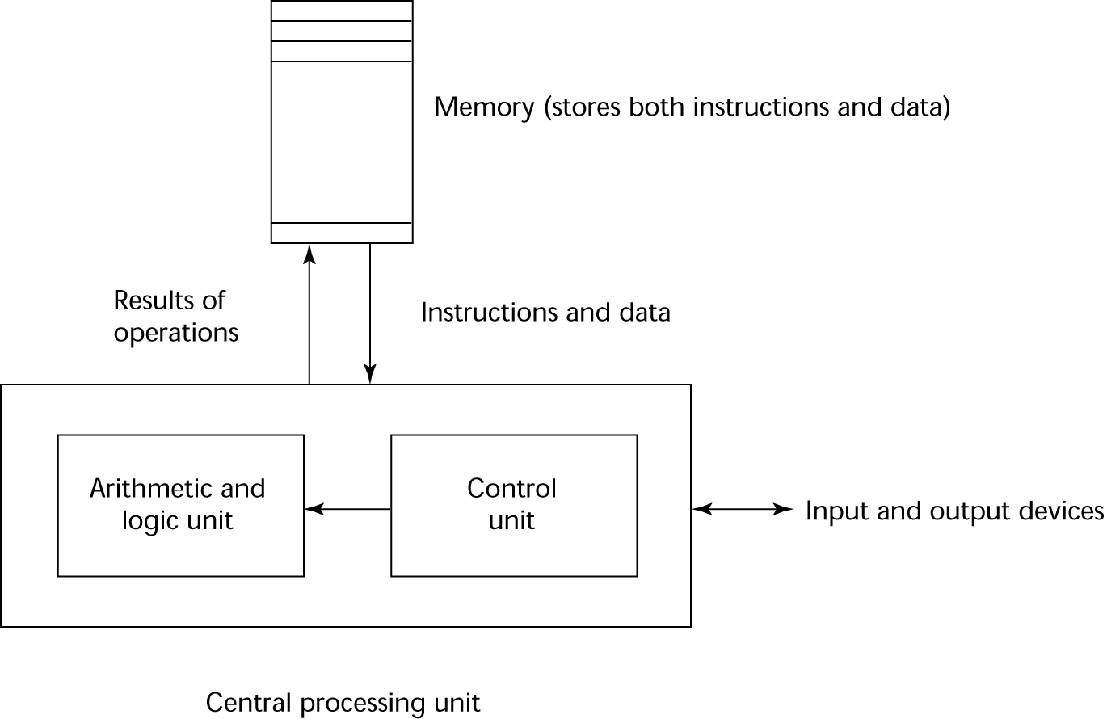
The Von Neumann Architecture

Slide 13
The von Neumann Architecture
Fetch-execute-cycle (on a von Neumann architecture computer)
initialize the program counter
repeat forever
fetch the instruction pointed by the counter
increment the counter
decode the instruction
execute the instruction
end repeat

Slide 14
Programming Methodologies Influences
1950s and early 1960s: Simple applications; worried about machine efficiency
Late 1960s: People efficiency became important; readability, better control structures
structured programming
top-down design and step-wise refinement
Late 1970s: Process-oriented to data-oriented
data abstraction
Middle 1980s: Object-oriented programming
Data abstraction + inheritance + polymorphism

Slide 15
Language Categories
Imperative
Central features are variables, assignment statements, and iteration
Include languages that support object-oriented programming
Include scripting languages
Include the visual languages
Examples: C, Java, Perl, JavaScript, Visual BASIC .NET, C++
Functional
Main means of making computations is by applying functions to given parameters
Examples: LISP, Scheme, ML, F#
Logic
Rule-based (rules are specified in no particular order)
Example: Prolog
Markup/programming hybrid
Markup languages extended to support some programming

Slide 16
Language Design Trade-Offs
Reliability vs. cost of execution
Example: Java demands all references to array elements be checked for proper indexing, which leads to increased execution costs
Readability vs. writability
Example: APL provides many powerful operators (and a large number of new symbols), allowing complex computations to be written in a compact program but at the cost of poor readability
Writability (flexibility) vs. reliability
Example: C++ pointers are powerful and very flexible but are unreliable

Slide 17
Implementation Methods
Compilation
Programs are translated into machine language; includes JIT systems
Use: Large commercial applications
Pure Interpretation
Programs are interpreted by another program known as an interpreter
Use: Small programs or when efficiency is not an issue
Hybrid Implementation Systems
A compromise between compilers and pure interpreters
Use: Small and medium systems when efficiency is not the first concern

Slide 18
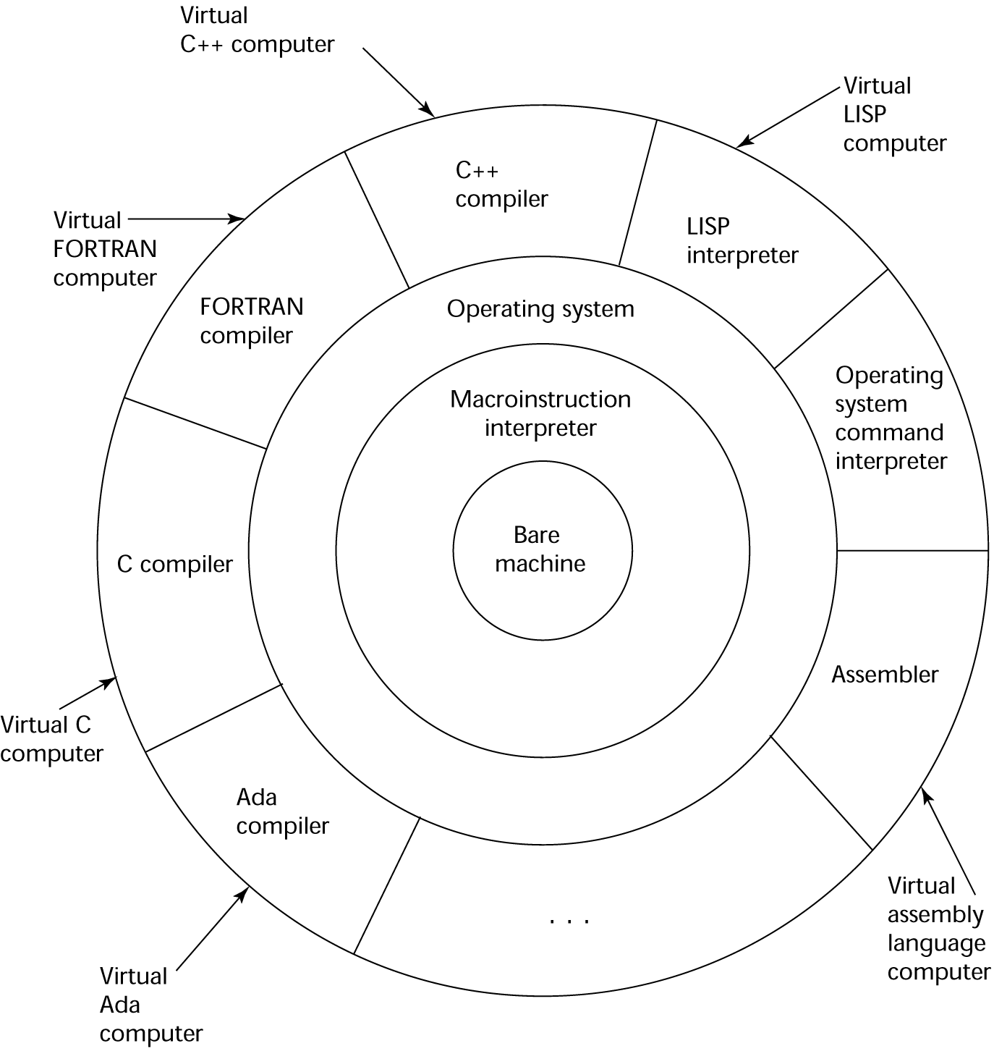
Layered View of Computer
The operating system and language implementation are layered over
machine interface of a computer

Slide 19
Compilation
What is it?
Translate high-level program (source language) into machine code (machine language)
Advantages?
Slow translation, fast execution
Compilation process has several phases:
lexical analysis: converts characters in the source program into lexical units
syntax analysis: transforms lexical units into parse trees which represent the syntactic structure of program
Semantics analysis: generate intermediate code
code generation: machine code is generated

Slide 20
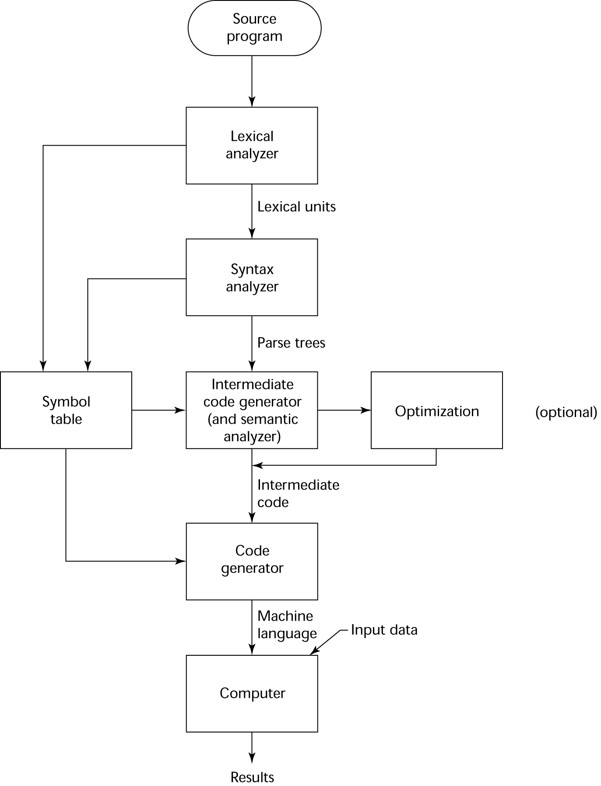
The Compilation Process

Slide 21
Additional Compilation Terminologies
Load module (executable image): the user and system code together
Linking and loading: the process of collecting system program units and linking them to a user program

Slide 22
Von Neumann Bottleneck
Connection speed between a computer’s memory and its processor determines the speed of a computer
Program instructions often can be executed much faster than the speed of the connection; the connection speed thus results in a bottleneck
Known as the von Neumann bottleneck; it is the primary limiting factor in the speed of computers, why?

Slide 23
Pure Interpretation
What is it?
No translation
Easier implementation of programs (run-time errors can easily and immediately be displayed)
Slower execution (10 to 100 times slower than compiled programs)
Often requires more space
Now rare for traditional high-level languages
Significant comeback with some Web scripting languages (e.g., JavaScript, PHP)

Slide 24
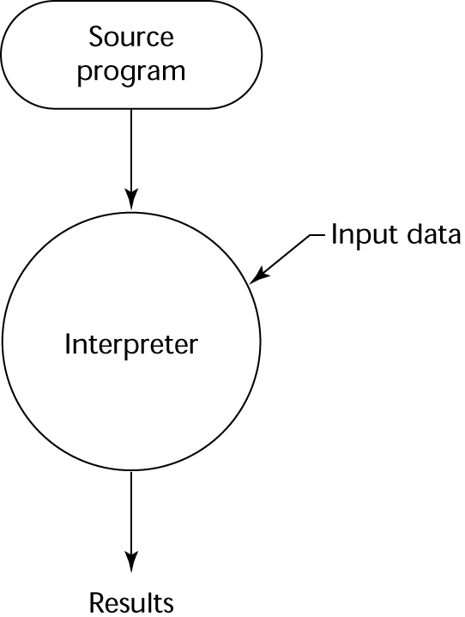
Pure Interpretation Process

Slide 25
Hybrid Implementation Systems
A compromise between compilers and pure interpreters
A high-level language program is translated to an intermediate language that allows easy interpretation
Faster than pure interpretation
Examples
Perl programs are partially compiled to detect errors before interpretation
Initial implementations of Java were hybrid; the intermediate form, byte code, provides portability to any machine that has a byte code interpreter and a run-time system (together, these are called Java Virtual Machine)

Slide 26
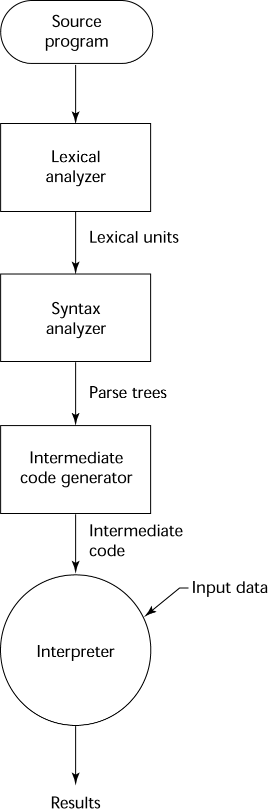
Hybrid Implementation Process

Slide 27
Just-in-Time Implementation Systems
Initially translate programs to an intermediate language
Then compile the intermediate language of the subprograms into machine code when they are called
Machine code version is kept for subsequent calls
JIT systems are widely used for Java programs
.NET languages are implemented with a JIT system
In essence, JIT systems are delayed compilers
Also known as dynamic translation

Slide 28
Preprocessors
Preprocessor macros (instructions) are commonly used to specify that code from another file is to be included
A preprocessor processes a program immediately before the program is compiled to expand embedded preprocessor macros
A well-known example: C preprocessor
expands #include, #define, and similar macros

Slide 29
Programming Environments
A collection of tools used in software development
UNIX
An older operating system and tool collection
Nowadays often used through a GUI (e.g., CDE, KDE, or GNOME) that runs on top of UNIX
Microsoft Visual Studio.NET
A large, complex visual environment
Used to build Web applications and non-Web applications in any .NET language
NetBeans
Related to Visual Studio .NET, except for applications in Java

Slide 30
Summary
The study of programming languages is valuable for a number of reasons:
Increase our capacity to use different constructs
Enable us to choose languages more intelligently
Makes learning new languages easier
Most important criteria for evaluating programming languages include:
Readability, writability, reliability, cost
Major influences on language design have been machine architecture and software development methodologies
The major methods of implementing programming languages are: compilation, pure interpretation, and hybrid implementation

